Slide 1
METAMODELING AND MODEL TRANSFORMATIONS IN MODELING AND SIMULATION
Deniz Cetinkaya, Alexander Verbraeck
Presented by
Tamanna Sultana Tonu
ID: 19101155
Course: CSE474
Section:01

Slide 2
SUMMARY
HYPOTHESIS:
Models as Primary Artifacts
Metamodeling for Formal Definitions
Model Transformations for Reuse
Different Views of the System
MDD in Modeling and Simulation

Slide 3
CONTRIBUTION:
MDD APPLIED INTO SIMULATION
MDD in Simulation
Benefits of MDD in Simulation
MDD4MS Framework
Challenges and Open Problem
CRITERIA FOR MODEL TRANSFORMATIONS
Evaluation Criteria for Model Transformations
Varied Approaches to Model Transformations

Slide 4
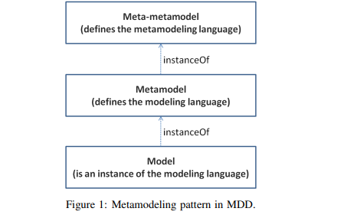
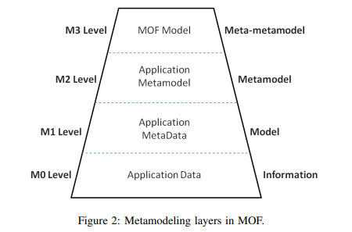
METHODOLOGY:
Basic MDD concepts
Metamodeling
Components of a Modeling Language
Metamodeling for DSMLs
Metamodeling Hierarchy
Common Metamodeling Languages
Model Transformations
Model Transformation Process
Endogenous vs. Exogenous Transformations
Types of Model Transformations
M2M and M2T Transformations
Popular Model Transformation Languages

Slide 5
CONCLUSION:
Selecting the Right Languages and Tools
Future Research in MDD Based on Proposed Criteria

Slide 6
LIMITATIONS
First limitation:
Insufficient Discussion of Specific Model Transformations
Second limitation:
Overemphasis on challenges

Slide 7
Synthesis
Improved simulation development
Domain-specific modeling languages
Tooling and framework
Integration with Emerging Technologies
Education and Training

Slide 8
REFERENCE
Metamodeling and model transformations in modeling and simulation | Proceedings of the Winter Simulation Conference

